Slide 1
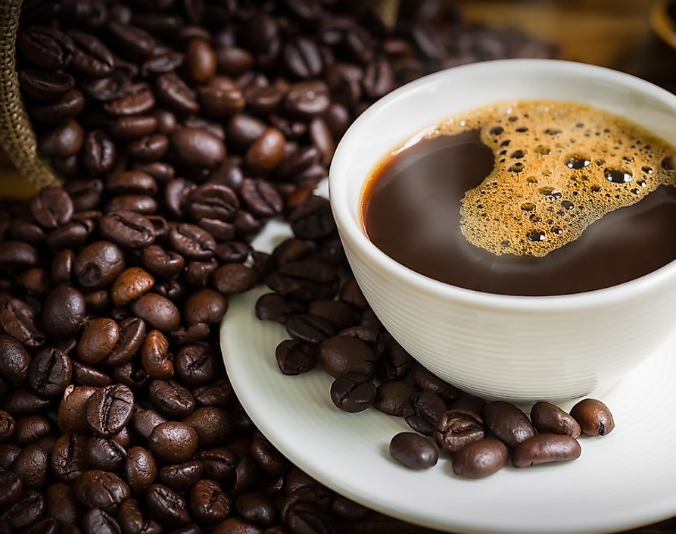
Barista Management at Quench, UW Dining Center
IMT 543 03/11/2022
Presented by - Saman Ateeq

Slide 2
Contents
Business Scope
Draft ERD
Revised ERD
Code Objects & Walkthrough
Stored Procedure
Business Rule
Computed Column
SQL Query
Key Takeaways

Slide 3
Business Scope
Quench is not a franchise of Starbucks, but it serves Starbucks coffee which is quite popular amongst students at the University of Washington. The database developed can be used to track weekly, monthly, quarterly, or yearly sales.
It can be used to manage the inventory and menu by analyzing which drink, syrups or milk are the most popular.
The database can be used by the Starbucks in the future to target customers and provide them monthly or weekly plan.

Slide 4
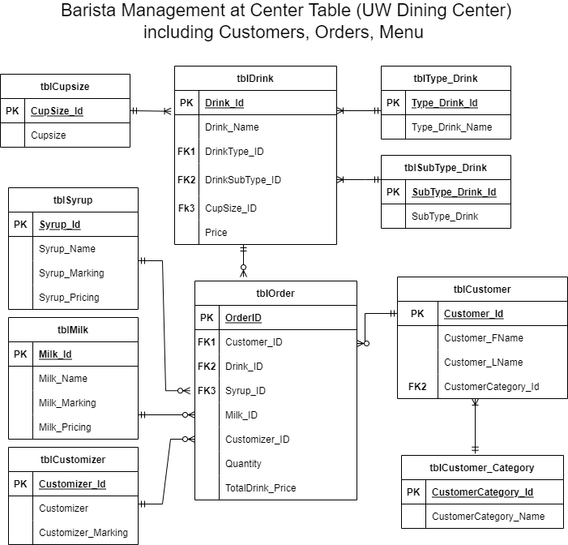
Draft ERD

Slide 5
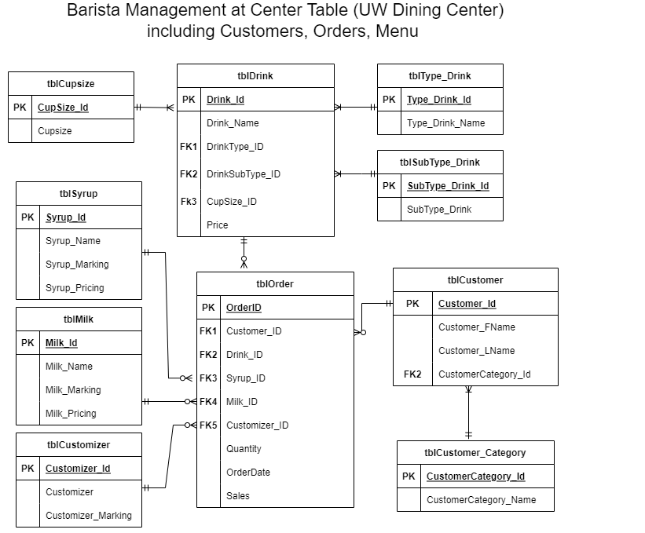
Revised ERD

Slide 6
Code Objects
Stored Procedure
To insert records into tblDrink and tblOrder tables
Leveraged nested stored procedures, error handling, and explicit transaction
Business Rule
Price of drinks can not be negative
A few drinks can not be hot, a few can not be cold, and rest can be both
Leveraged Alter Statement and Check constraint
Computed Columns
Total Sales column which includes tax, quantity, and price for customization in drink & Customer’s Full Name column
Created Function and Add Column
SQL Query
Which is the most popular drink size, syrup, and milk
Calculated YTD and MTD Sales
Leveraged group by, order by, multiple joins

Slide 7

Code Walkthrough

Slide 8
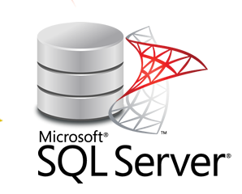
Key Takeaways
Developed database from scratch by implementing all three phases of SDLC- conceptual, Logical, Physical
Hands-on practice on SQL Server
Application of RDBMS concepts, e.g., ERD, Stored Procedure, Functions, Joins, DDL, DML scripts, etc.

Slide 9
Thank you !
sateeq@uw.edu

